Slide 1
Developing a Web-Interface for ChIP-seq QC and Comparative AnalysIs
Reddy Lab Meeting
August 23rd, 2017
Darryl Yan

Slide 2
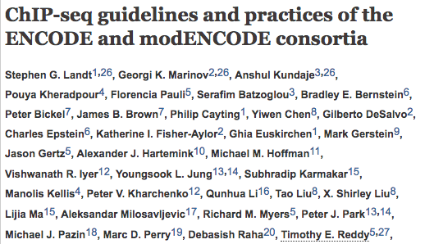
ChIP-seq quality control (QC) guidelines:
PCR Bottleneck Coefficient (PBC): Measure of PCR Bias + Library Complexity. Current ENCODE data standards recommend a PBC > 0.9.
Fraction of Reads in Peaks (FRiP): Measure of global enrichment. ENCODE scrutinizes experiments under that have a FRiP < 1% (w/ exceptions).
Non-Redundant Fraction (NRF): Library complexity, NRF > 0.8 are compliant.
Normalized Strand Coefficient (NSC) and Relative Strand Correlation (RSC): Measures signal to noise ratio in strand cross-correlation analysis. Addt’nl replicates required for NSC < 1.05 and RSC < 0.8

Slide 3
Proposal
Develop a publicly accessible and interactive web-interface for displaying ChIP-seq quality metrics and data visualizations to help researchers and lab technicians evaluate the performance of their experiments.
Compare the individual metrics of target experiments with previously analyzed datasets, contextualizing the values observed.
Attempt to devise a metric that can assess overall experiment quality consistently across experiments.

Slide 4
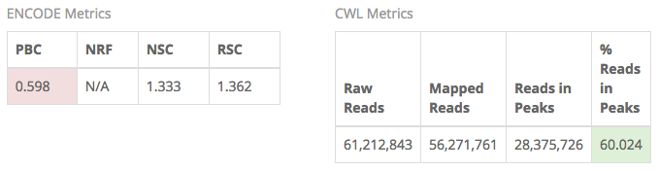
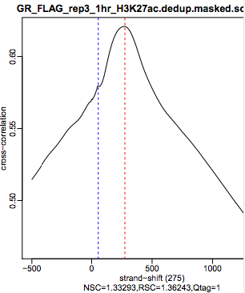
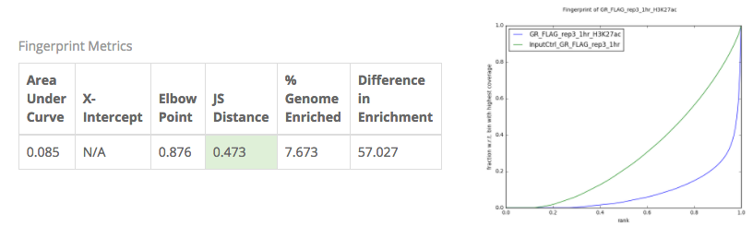
ChIP-DB Initial Release (v1.0)

Slide 5
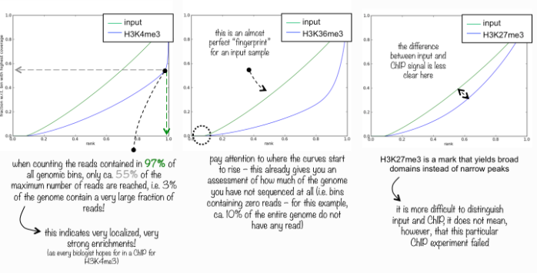
How CHIP-DB Works
MEAN (MongoDB, ExpressJS, Angular 2, and Node.js) application running on a Duke Machine.
Intended to be simple. Search-and-view the quality metrics per experiment, highlighting according to current data standards.
The data is pre-compiled using personal Python and Bash scripts from HARDAC.
No automation, must run scripts and update data every time new data comes in (2-4 hour process).
Includes a ”fingerprint analysis” from deepTools.

Slide 6
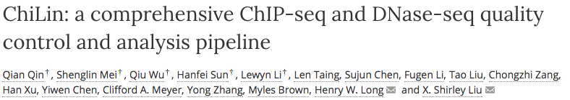

Slide 7
CWL Pipeline VS. Chilin
CWL
ChiLin
QC’s from all reads.
Bowtie(2) aligner.
Separate processing of data and QCs.
Implemented in CWL.
SPP analysis
QC’s from subsampling the first 4 million uniquely mapped reads.
Default BWA aligner (can specify)
Automated QC generation
Mycoplasma (configurable to other genome) check using 100,000 subsample.
‘Blacklist’ overlapping ratio.
‘QC atlas’ (thresholds) for data judgment.
Union DHS sites from ENCODE.

Slide 8
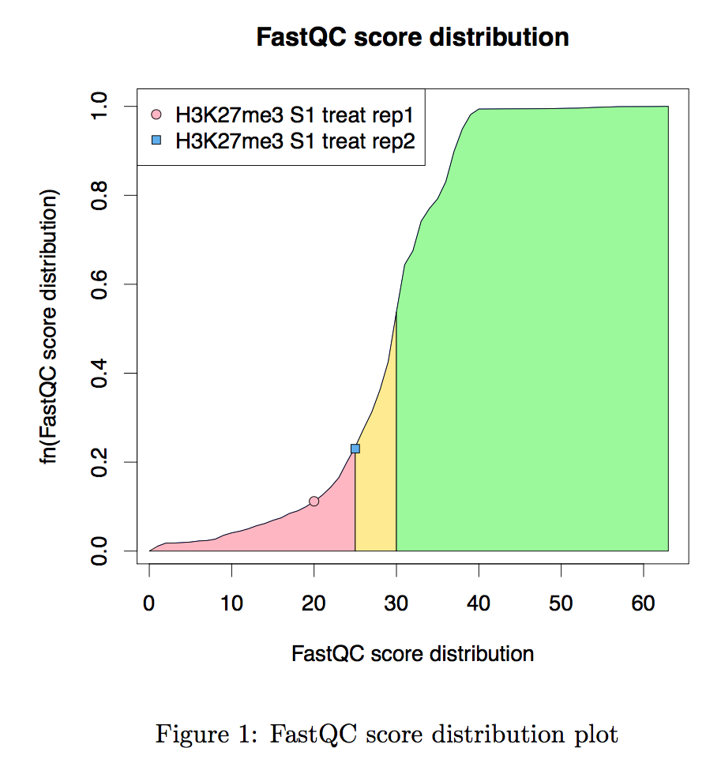
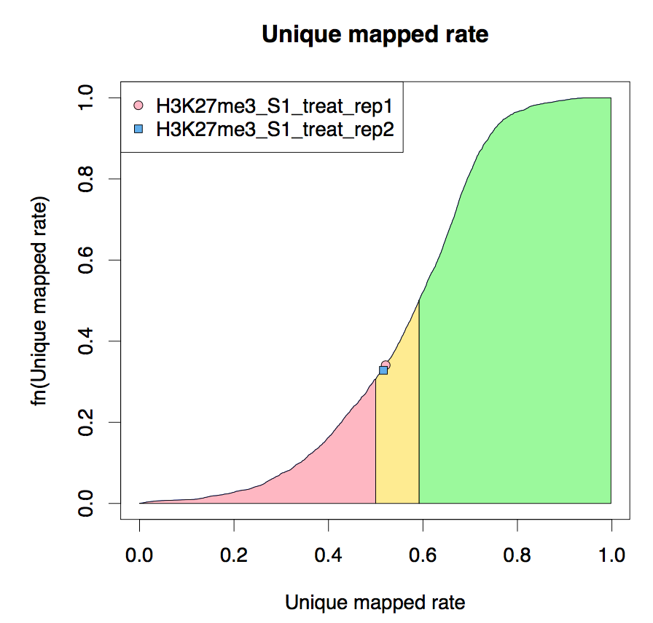

Slide 9
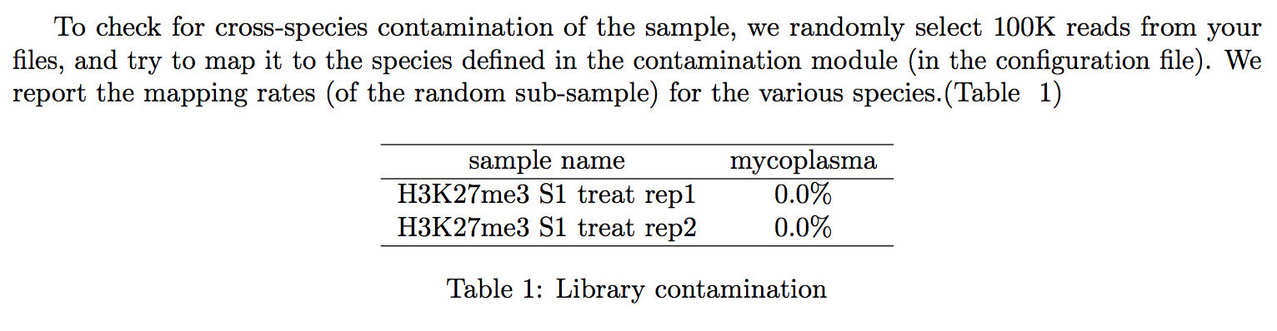
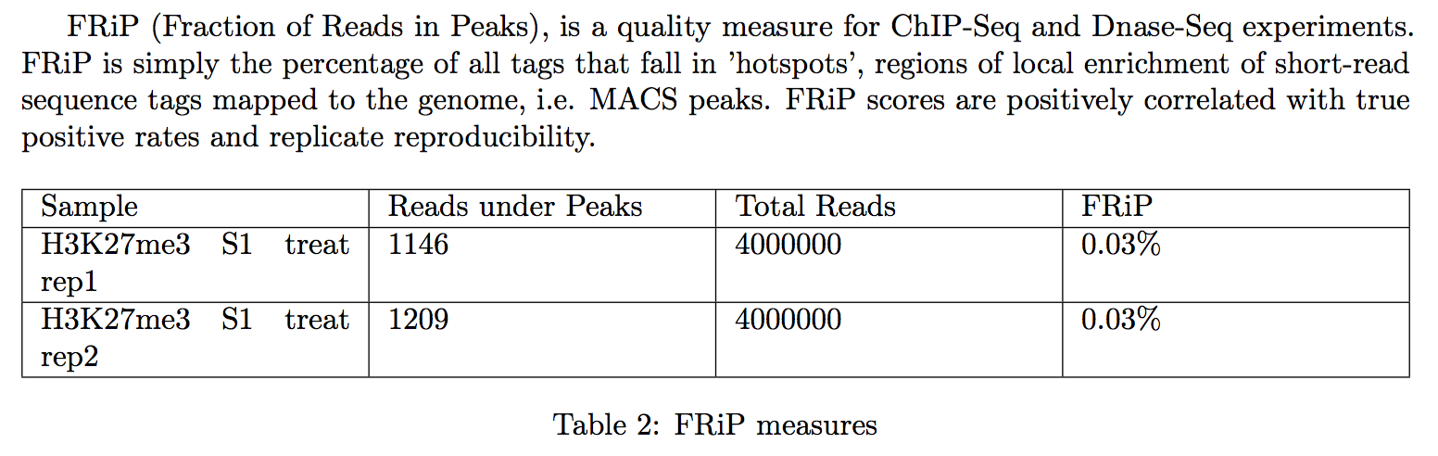

Slide 10
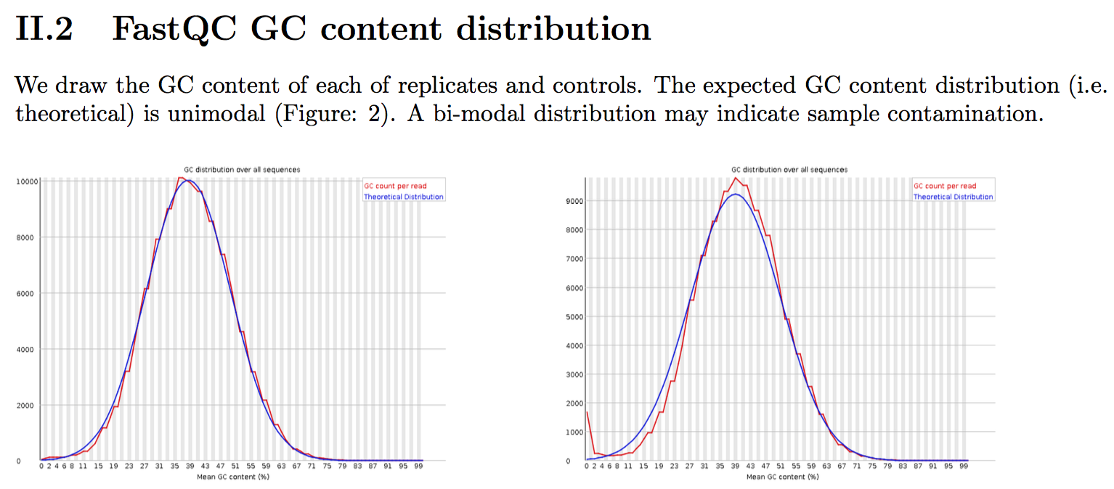

Slide 11
Notes:
A and B: Population of experiments in literature
C and D: ChIP layer troubleshooting, measures consistency issues between replicates

Slide 12
Notes:
Population distribution. Peaks overlapping with Exon, Intergenic, Intron, Promoter or Union DHS.

Slide 13
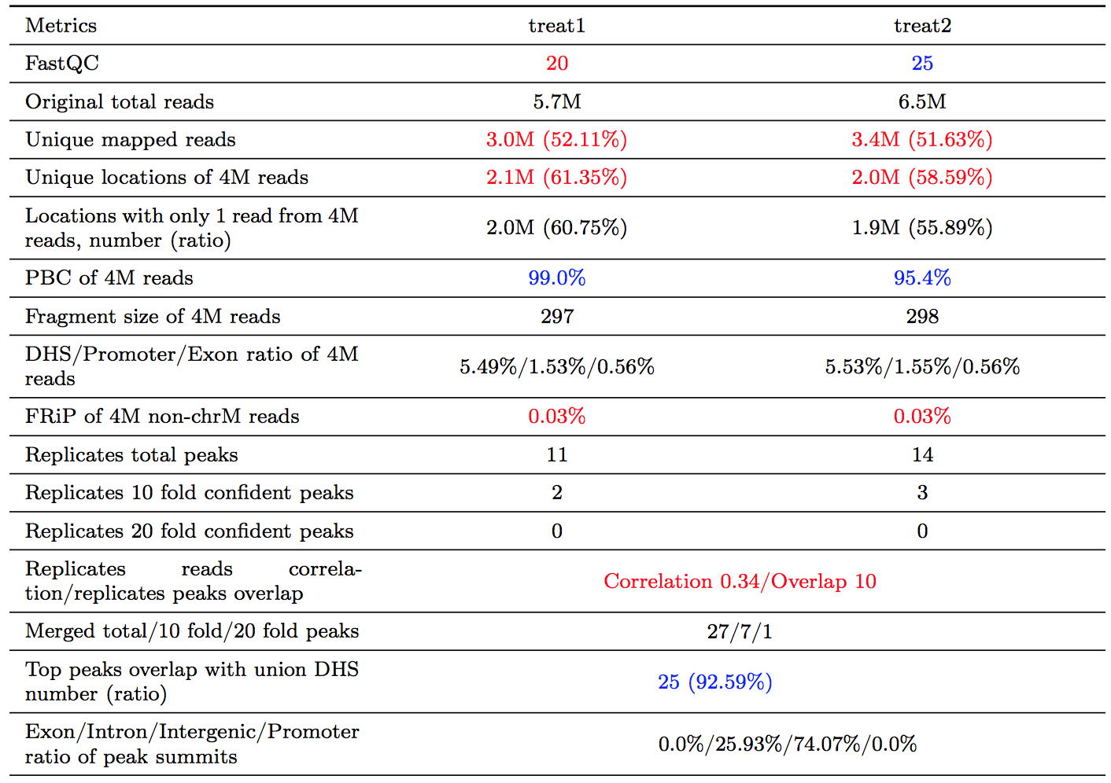
Reads Layer
ChIP
Layer
Annot.
Layer
Notes:
Top peaks (Top 5000) by MACS score

Slide 14
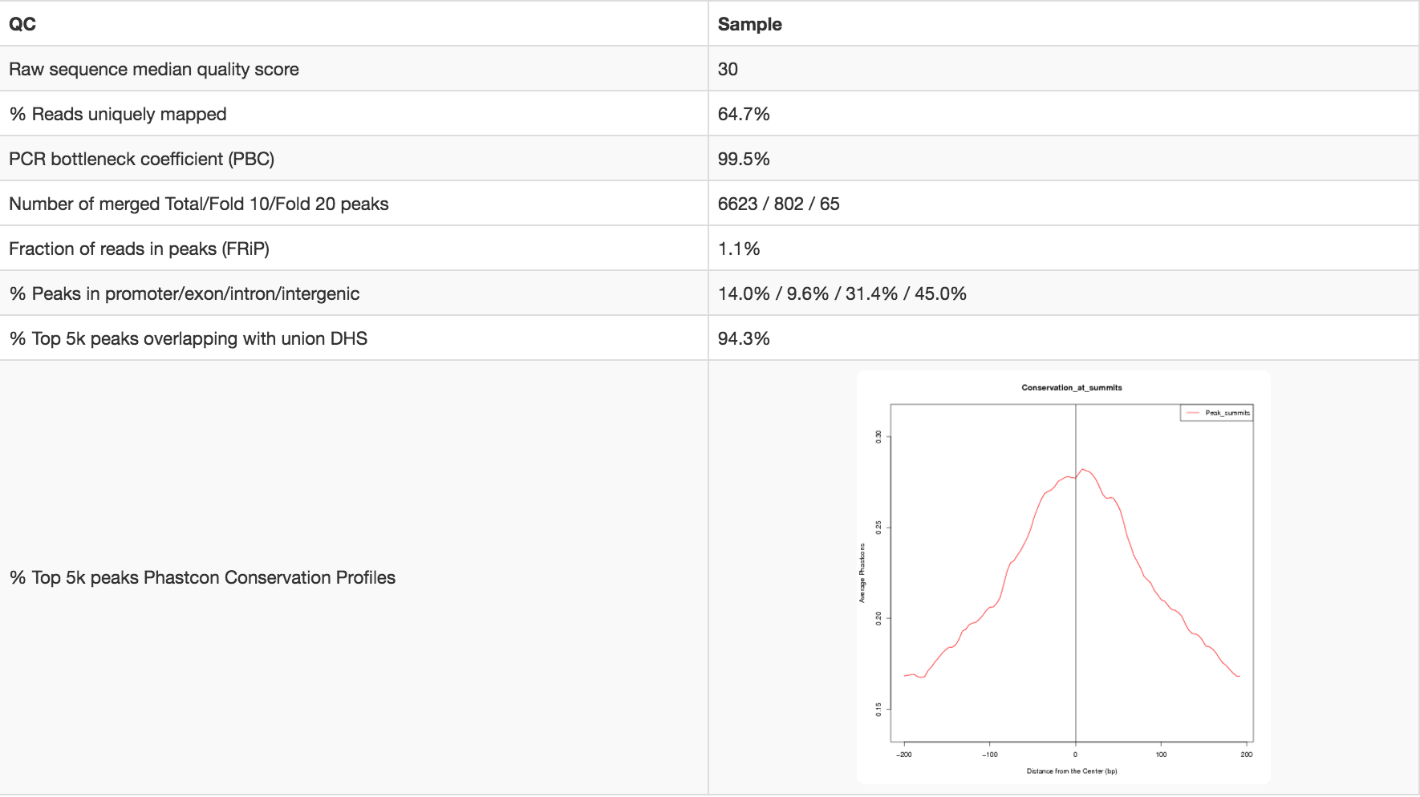
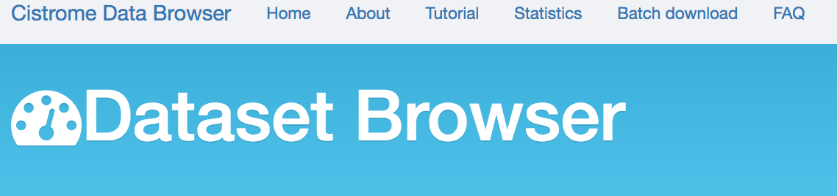
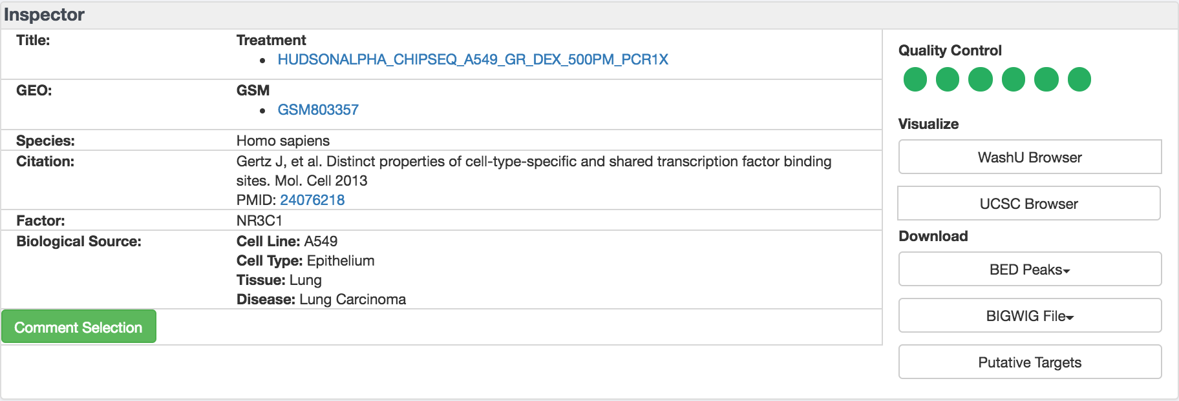
Figure 1: CistromeDB QC report
Figure 2: CistromeDB displays sample info

Slide 15
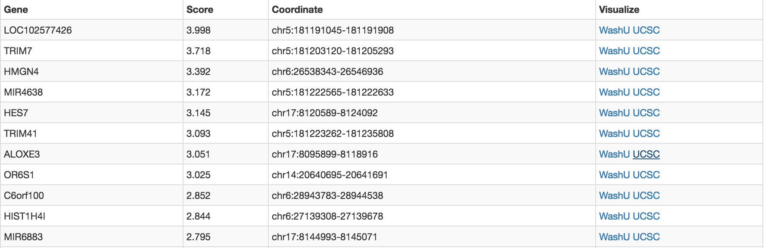
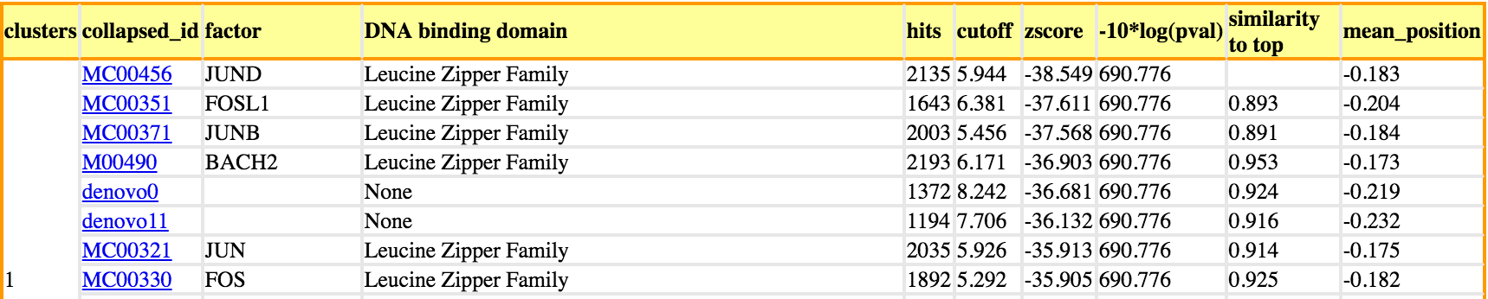
Figure 4. Top putative targets by regulatory potential score
Figure 5. QC motifs computed from ChiLin pipeline

Slide 16

Datasets on HARDAC
ChIP-DB (v2.0)
ChiLin

